Slide 1


Notes and Password Manager using Python
Submitted by: Ayush Vyas
Btech CSE
Univ roll no 2018755
Mentored by : Ms Tanusha Mittal

Slide 2


Introduction
Problem Statement
There are mainly two problems. The first problem is learning how to create secure passwords for online accounts.
And the second problem is learning how to maintain these passwords (remembering these passwords and keeping these passwords safe).
Password Managers
It is a piece of software that enables users to create, save, and manage login information for both local and internet services. usually focuses on establishing strong, impenetrable passwords.
Strong credentials may be generated and retrieved and deleted with its assistance, and their storage in encrypted databases or installation of software packages can be calculated.

Slide 3


About python password Manager
This password manager is designed in python language.
Python is a well-liked programming language for developing password managers due of its development community, sizeable library, and user-friendliness. Python has been used to implement a variety of password manager features, including safe password store, password creation, and password sharing.
The security of a password manager depends on how frequently it is used. Due to this, many articles may says the best practises for ensuring the security of password managers developed are with Python, such as the importance of user authentication and access control.

Slide 4

Methodology
Libraries Used:
Hashlib
Hashlib is a python library that contains hash functions for generating cryptographic hashes such as SHA-1, SHA-256, and SHA-512.
secrets
secrets is a Python standard library module that allows you to generate cryptographically secure random numbers and strings. It can be used to generate one-of-a-kind salts for salting passwords before hashing them.
csv
csv is a Python built-in library that allows you to read and write CSV (Comma Separated Values) files. It can be used to store hashed passwords as well as associated information like site, username, salt, and hash.

Slide 5
Methodology
Functions Used
The script contains several functions that perform various tasks:
masterHashCompare(password): compares the provided password to a salted hash stored in a master password file, returning True if the passwords match, False otherwise.
createMasterHashFile(password): if no salted hash master password file exists, it is created, and the passwords CSV file is initialised.
hashPassword(password, length): uses SHA-512 to create a salted hash of the given password and returns the salt and the number of characters in the hash.
writeCsv(site, username, salt, hash) adds a line to the passwords CSV file containing the specified site, username, salt, and hash.
readCsv(site): reads the passwords CSV file and returns the line corresponding to the given site if it exists.
deleteCsv(site): deletes the line for the specified site.

Slide 6

Methodology
Methods Used:
Passwords are hashed and salted using the hashlib library, while random salts are created using the secrets library and saved in a CSV file using the csv library. Users may create, retrieve, remove, and list password entries by site using the software. In order to use the password manager, the user must input a master password in the program's master password function. To achieve this, a salted hash of the master password entered is compared to the master password kept in a separate file. SHA-512 is widely used in a variety of applications, such as digital signatures, message authentication codes, and key derivation functions. It is used, for example, in the Digital Signature Algorithm (DSA), which is a digital signature standard in the United States. It is also used to ensure the integrity of data transmitted over the internet in various secure communication protocols such as SSL and TLS.

Slide 7
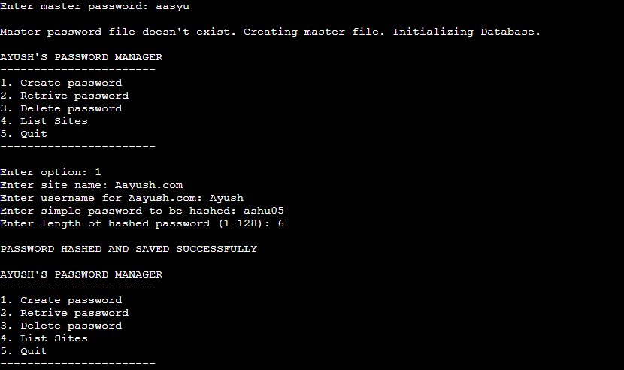
Result and Discussions
THE PROGRAM IS RUNNING PERFECTLY AS IT IS ASKING TO ENTER MASTER PASSWORD FIRST AND THE LET HIM IN TO CREATE A PASSWORD SO THAT HE CAN HASH SAVED PASSWORD

Slide 8
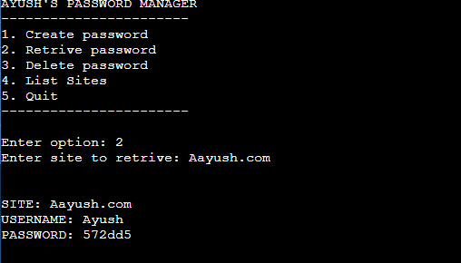
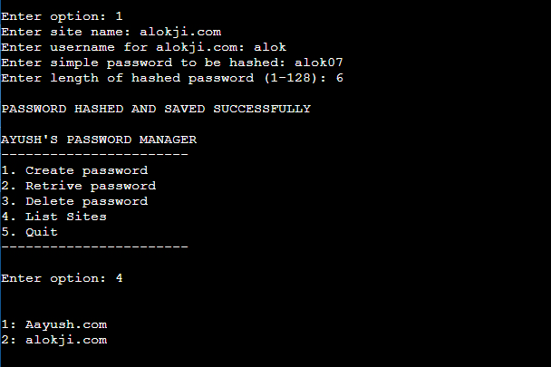
Result and Discussions
If we want to retrive password just click 2 and enter the desired site name see below
If we want to create another site and want to see how many sites are there click 1 for creation and then press option 4 for listing them see below

Slide 9
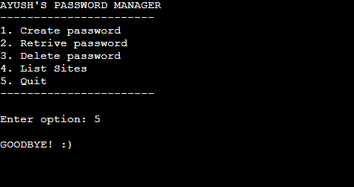
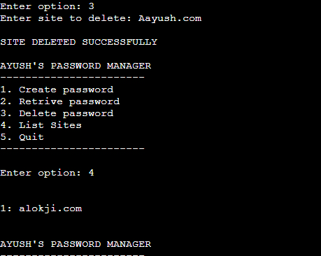
Result and Discussions
If we want to delete password and site goto option 3 which is for delete and just enter the desired site name and site will be deleted.
Just press 5 for exit. And you will be exited by a GOODBYE!:) message got printed.

Slide 10


Conclusion and Future Work
Conclusion
Password-based authentication is known to be insecure these days. This Password managers is available to help with these issues. This password managers provides you the facility of master password without it no one will be able to enter your password manager you can add new site retrive old and list the present ones also .hash 512 is used here.
Future work:
Password managers are useful in
Mobile Applications , graphic user interface applications ,
It prevents from many attacks like sql injection etc.
It also keeps your computer safe if it got infected with malware.it is very easy to manage password now no need to keep them remind

Slide 11


